Slide 1
English
Unit 2 – Sport
Monday 21st September 2026
WALT:
Begin to use if clauses in first conditionals.

Slide 2



WALT: Begin to use if clauses in first conditionals.
I can complete sentences in the first conditional.
I can write my own sentences in the first conditional.
I can write my own sentences in all the different forms of the first conditional.

Slide 3
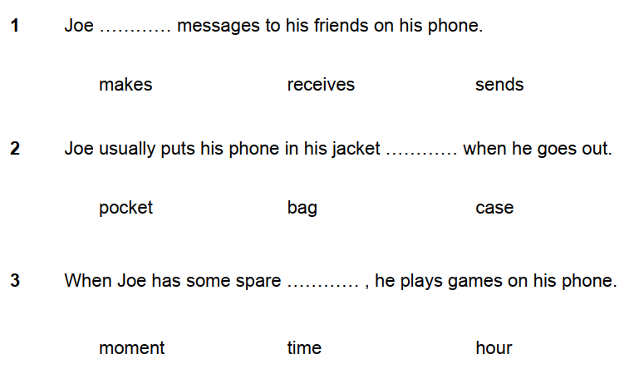
Retrieval Practice
WALT: Begin to use if clauses in first conditionals.

Slide 4
Starter – Correct the mistake in this sentence.
WALT: Begin to use if clauses in first conditionals.
I think if you will join the sports club, you will make lots of friends.

Slide 5
Starter – Correct the mistake in this sentence.
WALT: Begin to use if clauses in first conditionals.
I think if you will join the sports club, you will make lots of friends.

Slide 6
Starter – Correct the mistake in this sentence.
WALT: Begin to use if clauses in first conditionals.
I think if you join the sports club, you will make lots of friends.

Slide 7
The first conditional
WALT: Begin to use if clauses in first conditionals.
The sentence from the starter was written in the first conditional.
I think if you join the sports club, you will make lots of friends.
What do you think the first conditional is used for?

Slide 8
WALT: Begin to use if clauses in first conditionals.
The first conditional
The first conditional is used to refer to a likely outcome to a present or future situation.
If you study hard, you will do well in the test.
Present or future situation.
Likely outcome.

Slide 9
WALT: Begin to use if clauses in first conditionals.
The first conditional
Use this sentence structure to share some first conditional sentences with your partner.
If + present simple + then + future simple.
Examples:
If you eat too many sweets, you won’t eat your dinner.
If you don’t brush your teeth, you will need to go to the dentist.

Slide 10
You can also use “unless” instead of “if you don’t”.
WALT: Begin to use if clauses in first conditionals.
The first conditional
If the basketball team don’t improve their defense, the won’t win the championship.
Unless the basketball team improve their defense, the won’t win the championship.
The basketball team won’t win the championship unless they improve their defense.

Slide 11
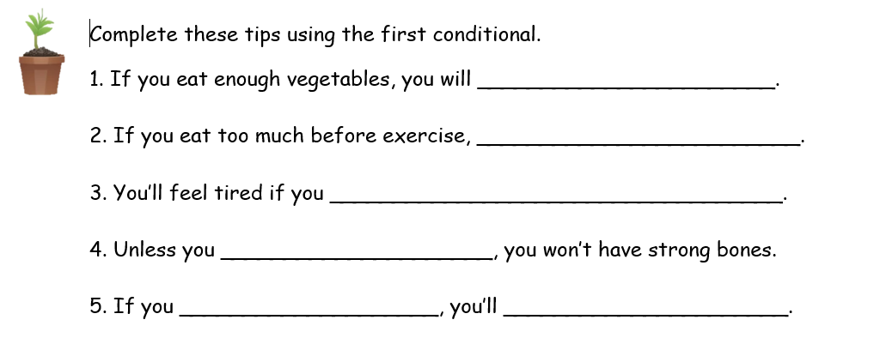
WALT: Begin to use if clauses in first conditionals.

Slide 12
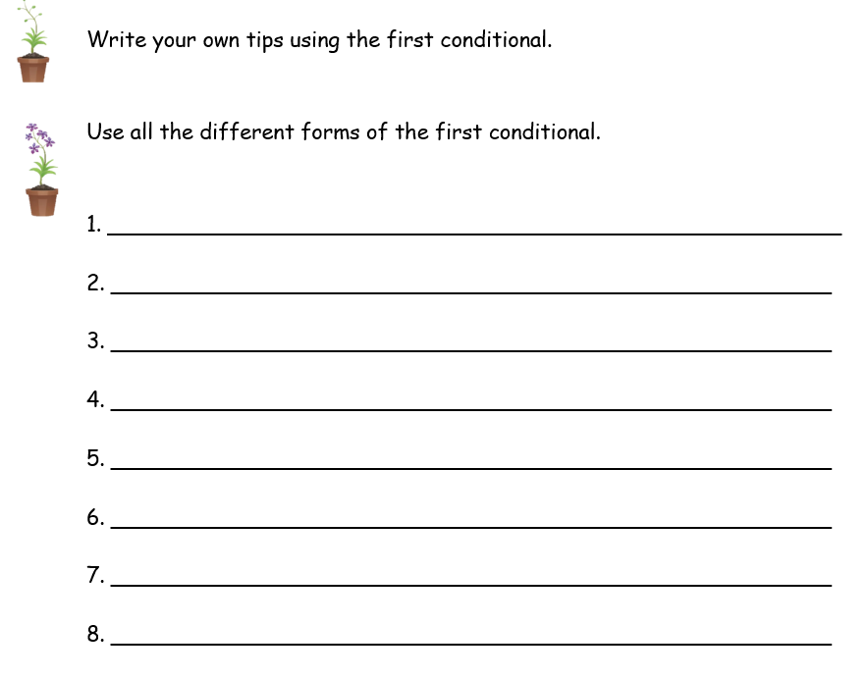
WALT: Begin to use if clauses in first conditionals.

Slide 13
Read your partner’s sentences.
WALT: Begin to use if clauses in first conditionals.
Be prepared to read your favourite to the class and justify why it’s your favourite.
If you work hard, we will have time to play a game.

